Slide 1


How to really use Anthropic Claude 3 Opus

Slide 2

"Art is never finished, only abandoned."
- Leonardo da Vinci

Slide 3
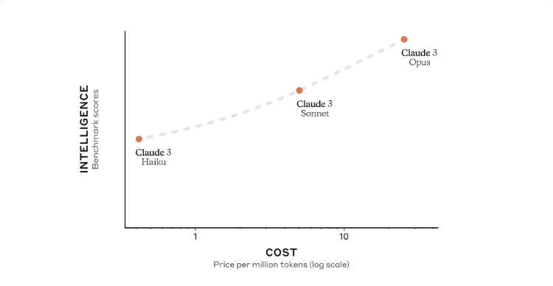
Faster
SPEED
Slower
Notes:
https://www.anthropic.com/news/claude-3-family

Slide 4
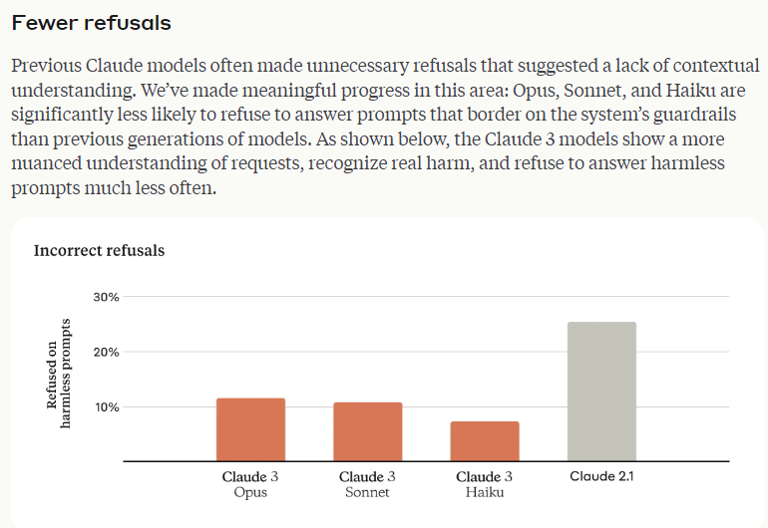
Notes:
https://www.anthropic.com/news/claude-3-family

Slide 5
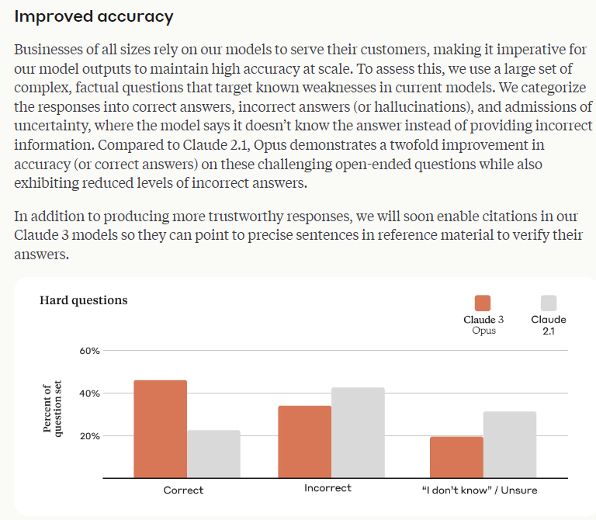

Slide 6
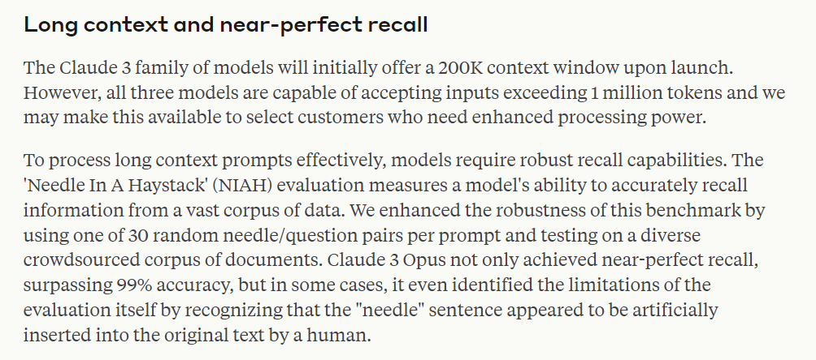

Slide 7
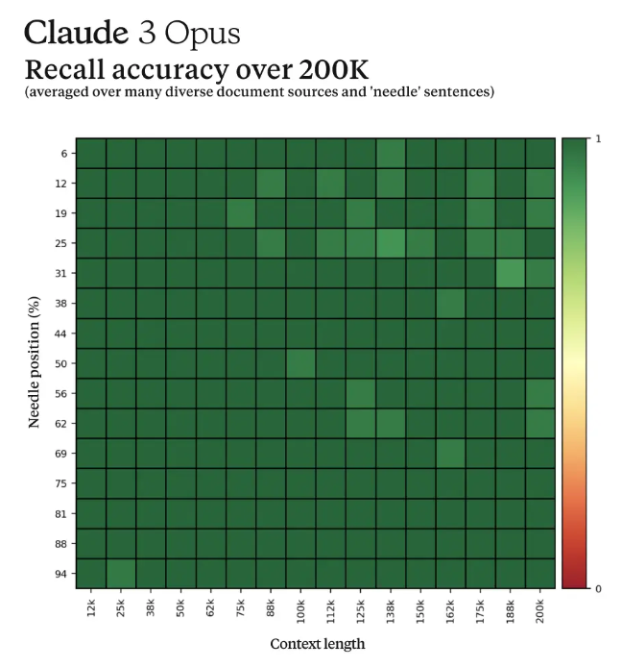

Slide 8
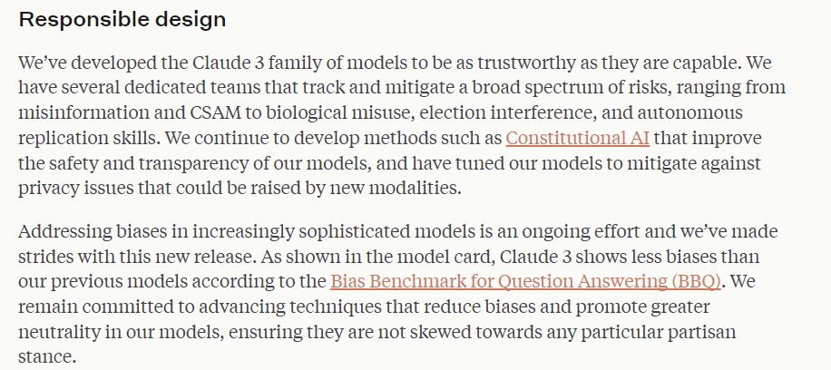

Slide 9

Getting Anthropic Claude 3 Opus

Slide 10
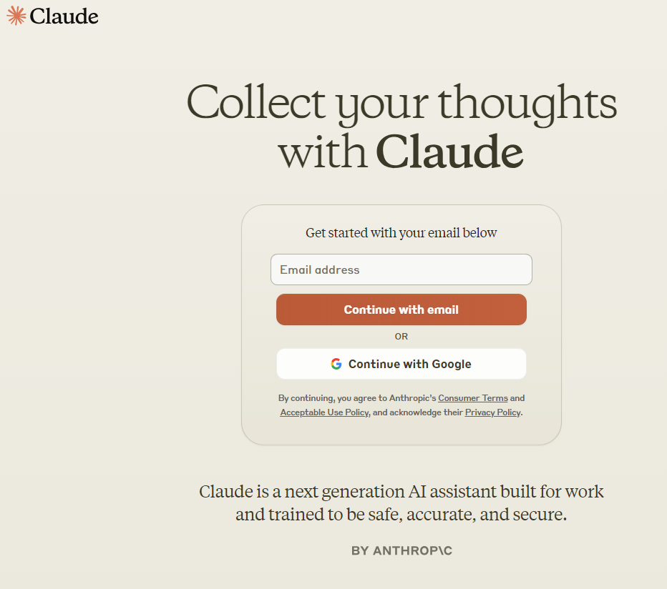
Anthropic Claude 3 Opus
Notes:
https://claude.ai/

Slide 11
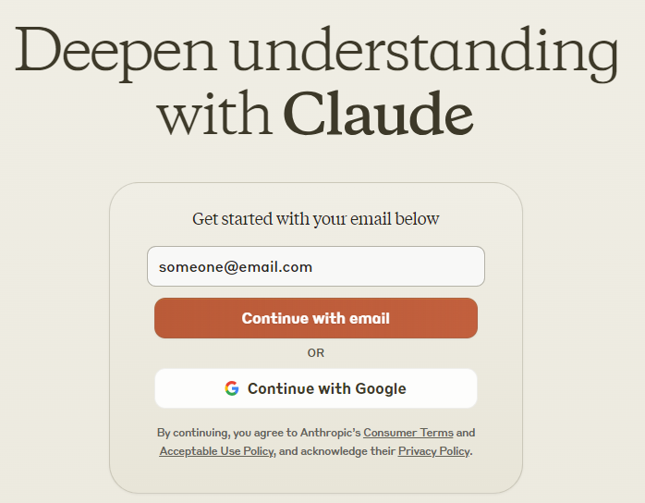

Slide 12
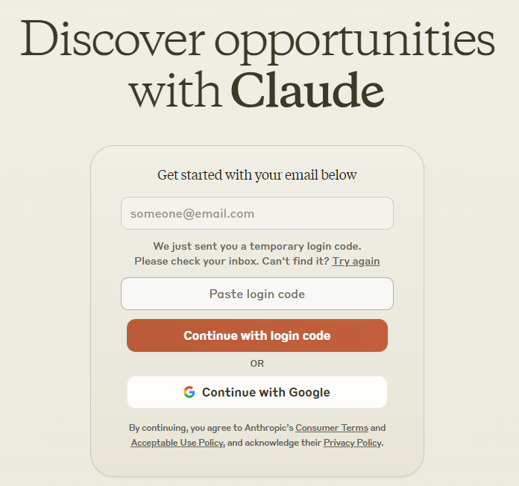

Slide 13
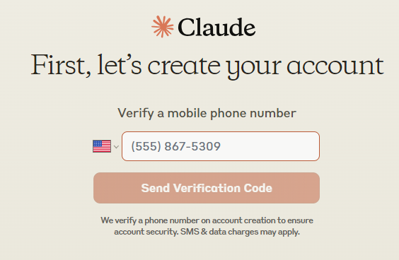

Slide 14
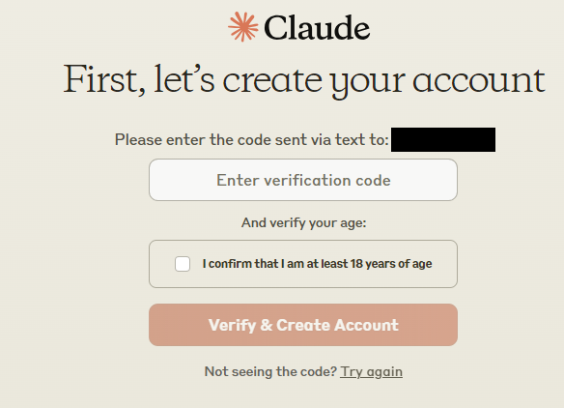

Slide 15
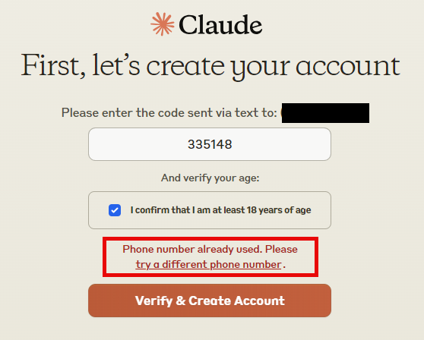

Slide 16
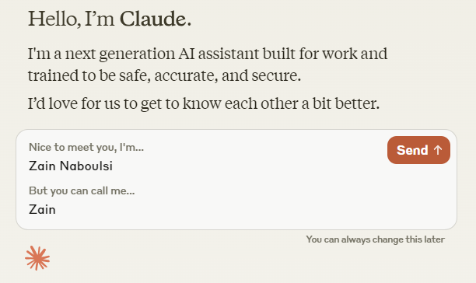

Slide 17
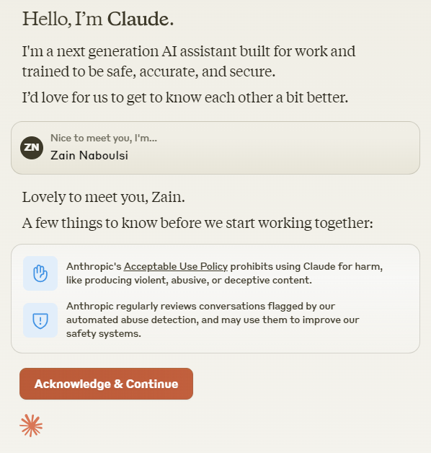

Slide 18
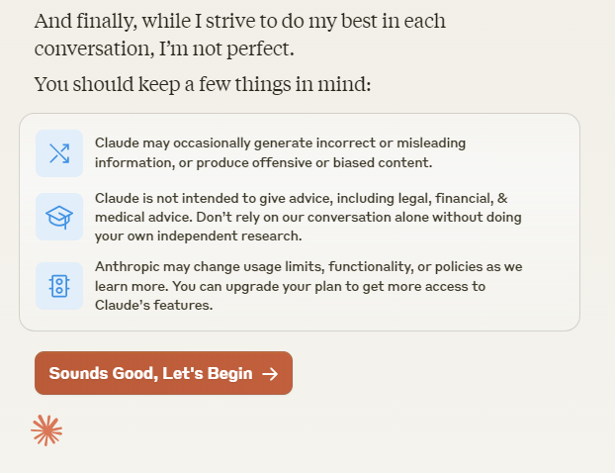

Slide 19
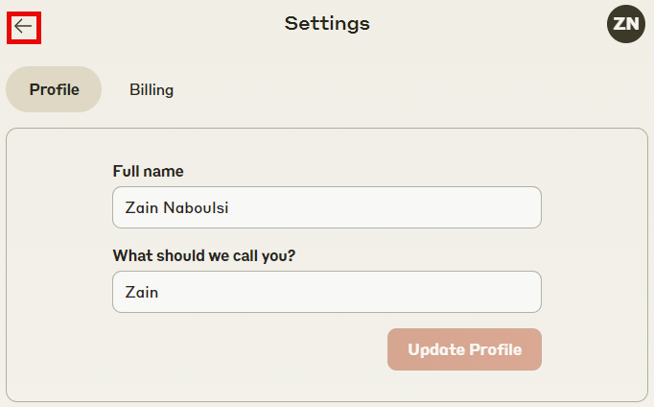

Slide 20
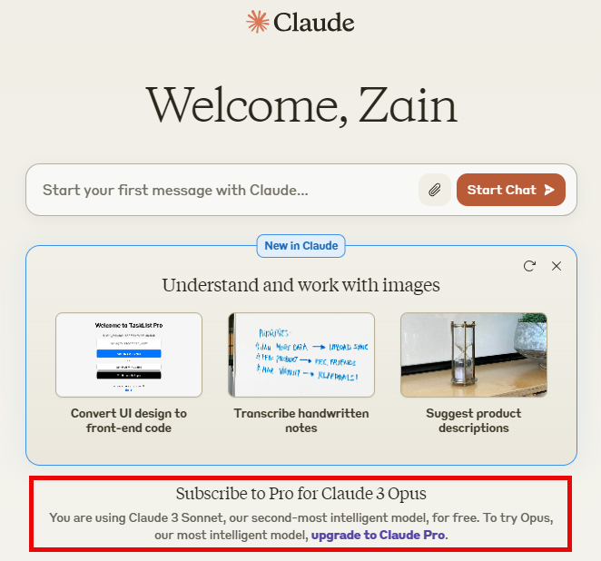

Slide 21
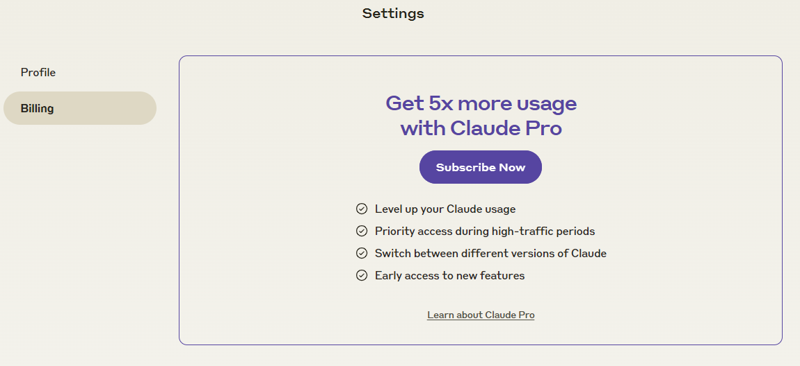

Slide 22
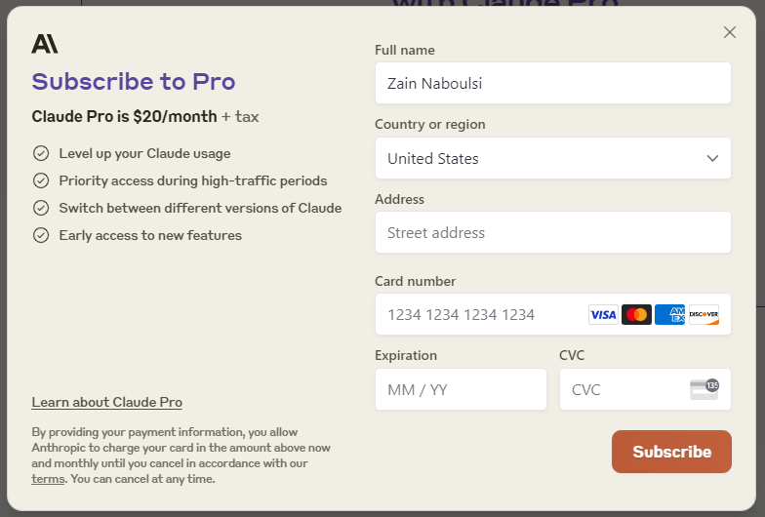

Slide 23

Limitations
Notes:
https://support.anthropic.com/en/articles/8324991-about-claude-pro-usage

Slide 24
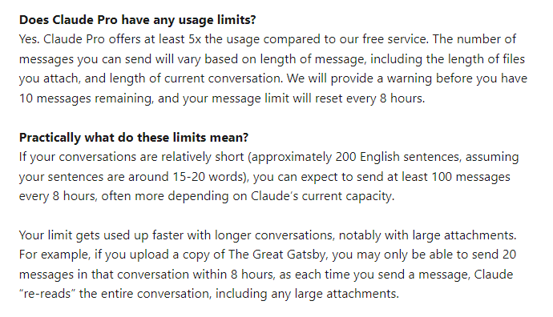

Slide 25
